Slide 1

CAP782-
RESPONSIVE WEB DESIGN
Lecture #0
The kick start session

Slide 2
LTP and credit details of the course
LTP – 3 0 2
[Three Lectures and Two Practical's in a week]
Credits-4

Slide 3

Revised Bloom’s Taxonomy

Slide 4
Course Outcomes
CO1 :: understand the need of responsive web design
CO2 :: employ the HTML5 elements
CO3 :: connect css to various HTML5 elements
CO4 :: appraise media query structure in stylesheets
CO5 :: develop responsive website focusing website optimization and performance

Slide 5
Program Outcomes
PO1 : Computational Knowledge : Apply knowledge of computing fundamentals, computing specialization, mathematics, and domain knowledge appropriate for the computing specialization to the abstraction and conceptualization of computing models from defined problems and requirements.
PO2 : Problem Analysis : Identify, formulate, research literature, and solve complex computing problems reaching substantiated conclusions using fundamental principles of mathematics, computing sciences, and relevant domain disciplines.
PO3 : Design /Development of Solutions : Design and evaluate solutions for complex computing problems, and design and evaluate systems, components, or processes that meet specified needs with appropriate consideration for public health and safety, cultural, societal, and environmental considerations.
PO4 : Conduct Investigations of Complex computing Problems : Use research-based knowledge and research methods including design of experiments, analysis and interpretation of data, and synthesis of t h e information to provide valid conclusions. Understand and commit to professional ethics and cyber regulations, responsibilities, and norms of professional computing practice.
PO5 : Modern Tool Usage : Create, select, adapt and apply appropriate techniques, resources, and modern computing tools to complex computing activities, with an understanding of the limitations.
PO6 : Professional Ethics : Understand and commit to professional ethics and cyber regulations, responsibilities, and norms of professional computing practice

Slide 6
Program Outcomes
PO7 : Life-long Learning : Recognize the need, and have the ability, to engage in independent learning for continual development as a computing professional.
PO8 : Project management and finance : Demonstrate knowledge and understanding of the computing and management principles and apply these to one ’s own work, as a member and leader in a team, to manage projects and in multidisciplinary environments.
PO9 : Communication Efficacy : Communicate effectively with the computing community, and with society at large, about complex computing activities by being able to comprehend and write effective reports, design documentation, make effective presentations, and give and understand clear instructions
PO10 : Societal and Environmental Concern : Understand and assess societal, environmental, health, safety, legal, and cultural issues within local and global contexts, and the consequential responsibilities relevant to professional computing practice.
PO11 : Individual and Team Work : Function effectively as an individual and as a member or leader in diverse teams and in multidisciplinary environments.
PO12 : Innovation and Entrepreneurship : Identify a timely opportunity and using innovation to pursue that opportunity to create value and wealth for the betterment of the individual and society at large.

Slide 7
The course contents
Getting started with responsive web design
HTML5 structure for website
Using CSS
Creating responsive websites with media query and images
Adding media queries to fluid layout
Working responsively: mobile and beyond
Creating responsive websites to improve performance

Slide 8
Course Assessment Model
Marks break up
Component | Marks
Attendance | 5
CA (3 best out of 4) | 45
ETP | 50
Total | 100

Slide 9
Evaluation Criteria
4 Continuous Evaluations
  Each Evaluation is progressive in nature.
  Focus on new skills learning

Slide 10
Practical Applications of the Subject
Development of responsive websites.
Professional and Visually appealing websites
Optimize the websites for multiple devices and multiple platforms
Optimize the websites for performance

Slide 11
Relevant resources
https://www.w3schools.com/css/css_rwd_intro.asp
https://www.freecodecamp.org/news/learn-responsive-web-design-in-5-minutes/
https://www.tutorialspoint.com/css/css_responsive.htm

Slide 12
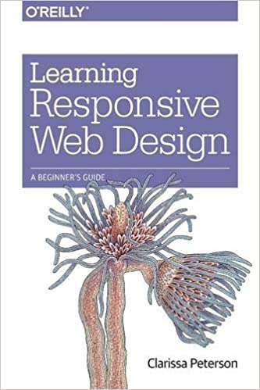


Text book and reference book
Text Book
Reference Book
Reference Book

Slide 13
Skill set attainment
Responsive Website Development
Website performance optimization
Visually appealing website/ Improved website aesthetics

Slide 14
MOOC
Responsive Web Design MOOC available from Coursera
https://www.coursera.org/learn/responsive-web-design?utm_source=gg&utm_medium=sem&utm_campaign=B2C_INDIA_google-it-support_FTCOF_professional-certificates_PMax-arte-non-NRL_within_14D&utm_content=B2C&campaignid=19009590676&adgroupid=&device=c&keyword=&matchtype=&network=x&devicemodel=&adpostion=&creativeid=&hide_mobile_promo&gclid=Cj0KCQiAzeSdBhC4ARIsACj36uFwa-dzULCcMT-J-u2Cias26reAkAc-WmK_Wu5tOsqeJbsGhJK2pLsaApOLEALw_wcB

Slide 15

Questions???

